Slide 1
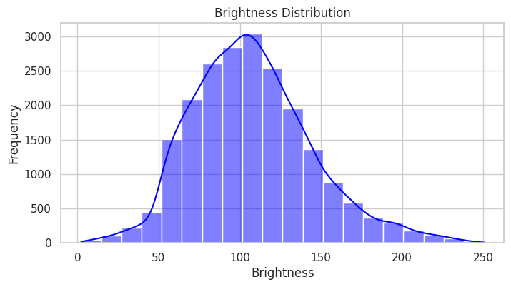

EXPLORATORY DATA ANALYSIS
DATASET CHARACTERISTICS
Brightness
Right-skewed
Preprocessing Guidance
INSIGHTS
Notes:
Thank you, Daniel! Let’s explore a couple of key EDA observations. This brightness distribution shows most images fall between 100 and 120, with fewer extremely dark or bright samples. Low brightness, below 50, can obscure text, while high brightness, above 180, risks washing it out. Preprocessing adjustments, such as normalization and contrast enhancement, are essential to standardize image quality. It will improve OCR accuracy and robust model performance.

Slide 2
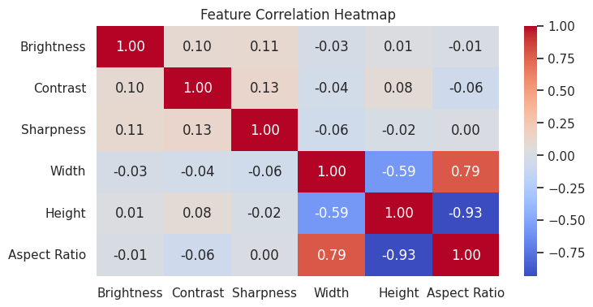
feature analysis
CORRELATION HEATMAP
Aspect Ratio and Height
Aspect Ratio and Width
Contrast and Sharpness
Notes:
Next, let’s examine our Feature Analysis using the Correlation Heatmap. The strongest correlation is between aspect ratio and height, indicating that taller images are narrower and require resizing to maintain text proportions during preprocessing. Aspect ratio and width show that wider images correlate with higher aspect ratios, emphasizing the need for consistent width scaling. The correlation between contrast and sharpness highlights that sharper images improve contrast, enhancing text clarity. These findings underscore the importance of tailored resizing, sharpening, and contrast adjustments to standardize inputs and achieve optimal OCR accuracy

Slide 3
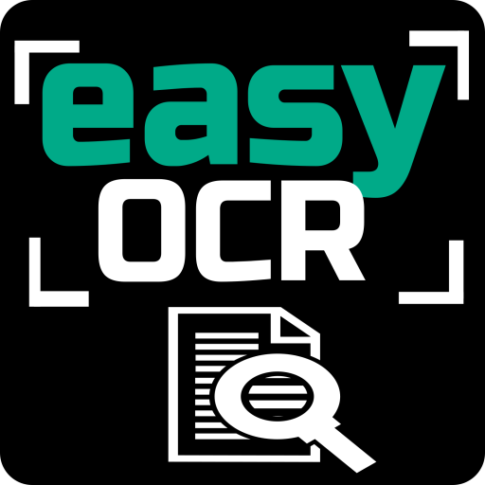
Modeling methods AND ALGORITHMS
EasyOCR
Lightweight Efficiency
Pre-trained Model
Rule-Based Detection
Language-Specific Reader
Ideal for Simplicity
Limitations in Noise
easyocr.Reader(["en"])
(UBIAI, 2022)
Notes:
We implemented EasyOCR as one of the two OCR approaches. EasyOCR is a lightweight, pre-trained tool that uses rule-based methods to detect and extract text from images. By configuring a language-specific reader (easyocr.Reader(["en"])), we efficiently processed image data, focusing on simpler layouts with clear text. EasyOCR was especially effective for straightforward text recognition due to its speed and ease of use. However, the rule-based design revealed limitations in handling noisy data, distorted text, or complex layouts. Despite this, EasyOCR provided a reliable foundation for text extraction in simpler scenarios.

Slide 4


Modeling methods AND ALGORITHMS
TrOCR
Transformer-Based Model
VisionEncoderDecoder Architecture
Handles Complex Layouts
RGB Preprocessing
Text Tokenization
High Accuracy
Notes:
TrOCR, a transformer-based model that integrates image processing and text generation using its VisionEncoderDecoder architecture. The model’s ability to handle complex layouts, including noisy backgrounds and varied text orientations, makes it highly effective for advanced OCR tasks. TrOCR leverages RGB preprocessing to ensure images are optimally prepared for pixel value extraction, while text tokenization transforms model outputs into readable text. The code snippet illustrates the initialization of TrOCR's processor and model, essential components for processing images and generating predictions.

Slide 5
Training and validation
EasyOCR
No Training Required
WER/CER Validation
Rule-based design
Handles simple layouts
TrOCR
VisionEncoderDecoder
RGB Preprocessing
Tokenizer for decoding
Pre-trained evaluation
Handles complex layouts
Notes:
For EasyOCR, we leveraged its pre-trained capabilities, bypassing the need for additional training. Validation was straightforward, utilizing Word Error Rate (WER) and Character Error Rate (CER) to assess performance against ground truth text. While its efficiency made it ideal for clean, simple layouts, its rule-based approach struggled with noisy or distorted text.
For TrOCR, its transformer-based VisionEncoderDecoder architecture was utilized to process preprocessed RGB images into pixel values. Following the modeling method snippet, predictions were generated and decoded using its tokenizer. Validation compared these predictions to ground truth using WER and CER, showcasing its ability to handle complex layouts without further fine-tuning.

Slide 6
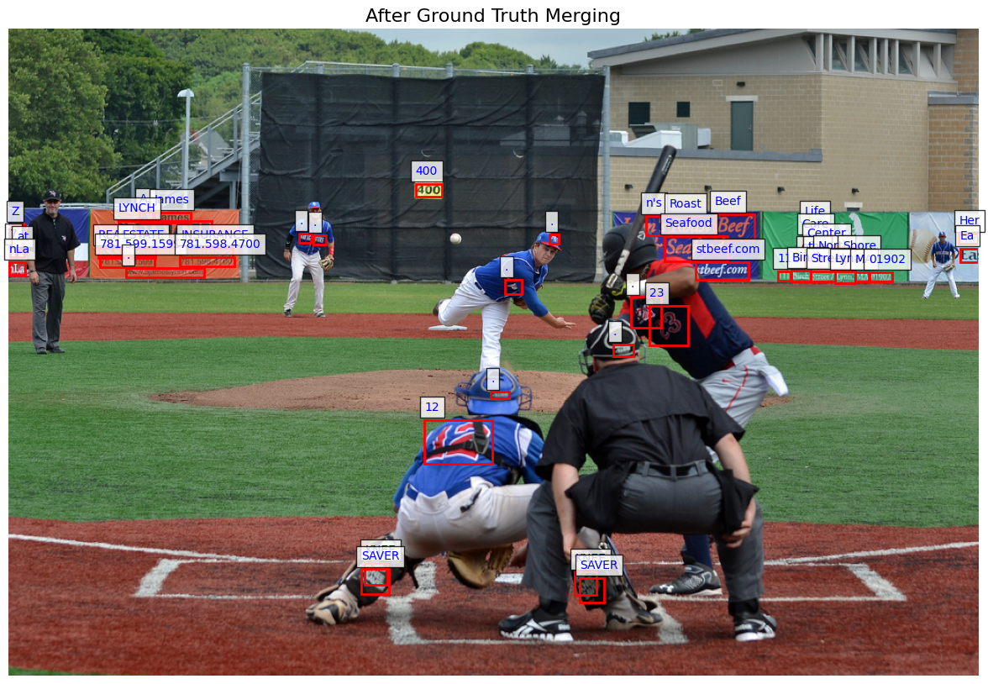
ground truth
Why it’s important!
OCR model evaluation
Benchmark for Metrics
Ensures Prediction Alignment
Calculates WER/CER
Highlights Model Strengths
Validates Diverse Text
Notes:
Ground truth is essential for OCR model evaluation, providing the benchmark for measuring performance. Accurate annotations paired with bounding boxes align predictions with the original text in the images, enabling reliable computation of performance metrics like WER and CER. Without ground truth, these metrics cannot be computed, and evaluation would lack a reference point. Ground truth also serves as a debugging tool, revealing misalignments between predictions and annotations to identify preprocessing or modeling issues. By incorporating diverse text orientations and sizes, we ensured a comprehensive validation process that captured each model's strengths and limitations, refining performance insights.

Slide 7
Team contributions
Jay patel
Daniel shifrin
Outhai xayavongsa
Chose Final Dataset
Contributed to Status Update Form
Notebook
Data Setup & Data Cleaning
Attempted YOLO
Attempted Keras OCR
Attempted PaddleOCR
Attempted Tesseract
Attended all Meetups
Technical Report
Data Cleaning and Preprocessing
Results and Analysis, Findings, Discussion, and Conclusion
PowerPoint
Performance metrics
Results and Findings
Conclusion and Future Work
Contributed to Status Update Form
Notebook
Exploratory Data and Feature Analysis
Attempted EasyOCR
Attended all Meetups
Technical Report
Introduction
EDA and Feature Analysis
PowerPoint
Title and Introduction
Dataset discussion
Data Cleaning
Data Preprocessing
Found Datasets
Contributed to Status Update Form
Created Task List & Organize Meetups
Notebook
Data Clean Image
Preprocess Image
Adjusted EDA
TrOCR Model
Created Ground Truth
Worked on EasyOCR Model
Attempted CRNN Model
Completed Training, Validation
Completed WER/CER Metrics
Technical Report
Title, Abstract, References
Revised EDA and Figure 1to 4
Model Training, Validation, Metrics
Added Figure 5 to Results
PowerPoint
Exploratory Data and Feature Analysis
Modeling methods and Algorithms
Training Validation
Ground Truth
Team Contributions
GitHub ReadMe and Organization
Submit all Deliverables

